Slide 1

A Day With Go
Notes:
Starting from golang installation, until we developed a production ready golang application

Slide 2
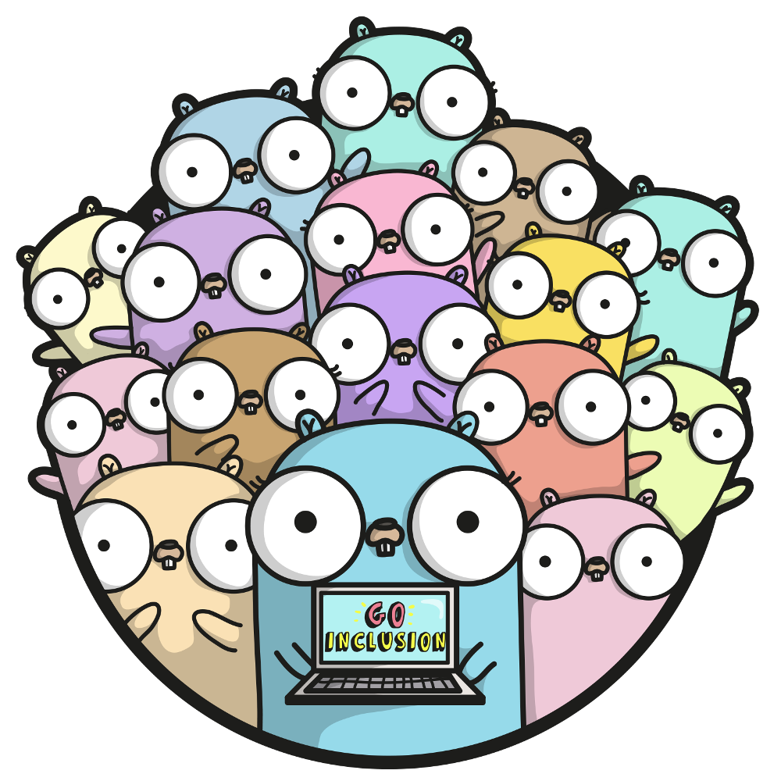


Who we are?
Engineering
Notes:
We are pickme engineering team
We have developed 150+ microservices with golang
We have over 3 years of golang knowledge
Who will be doing the sessions and small introduction to presenters, srimal,nipuna,wishwa

Slide 3

Why GO?
Notes:
There are many reasons to use go over other languages, let’s have a look at it
Run 70,000 requests per second with just 20MB of RAM

Slide 4
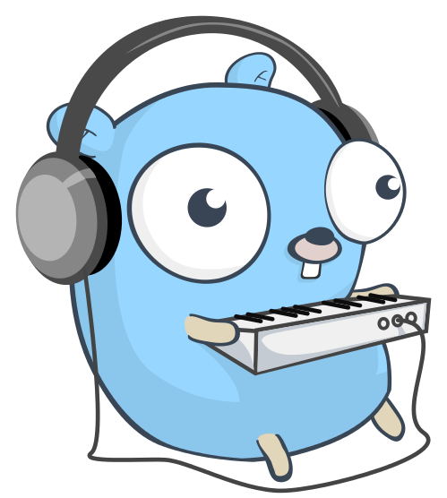

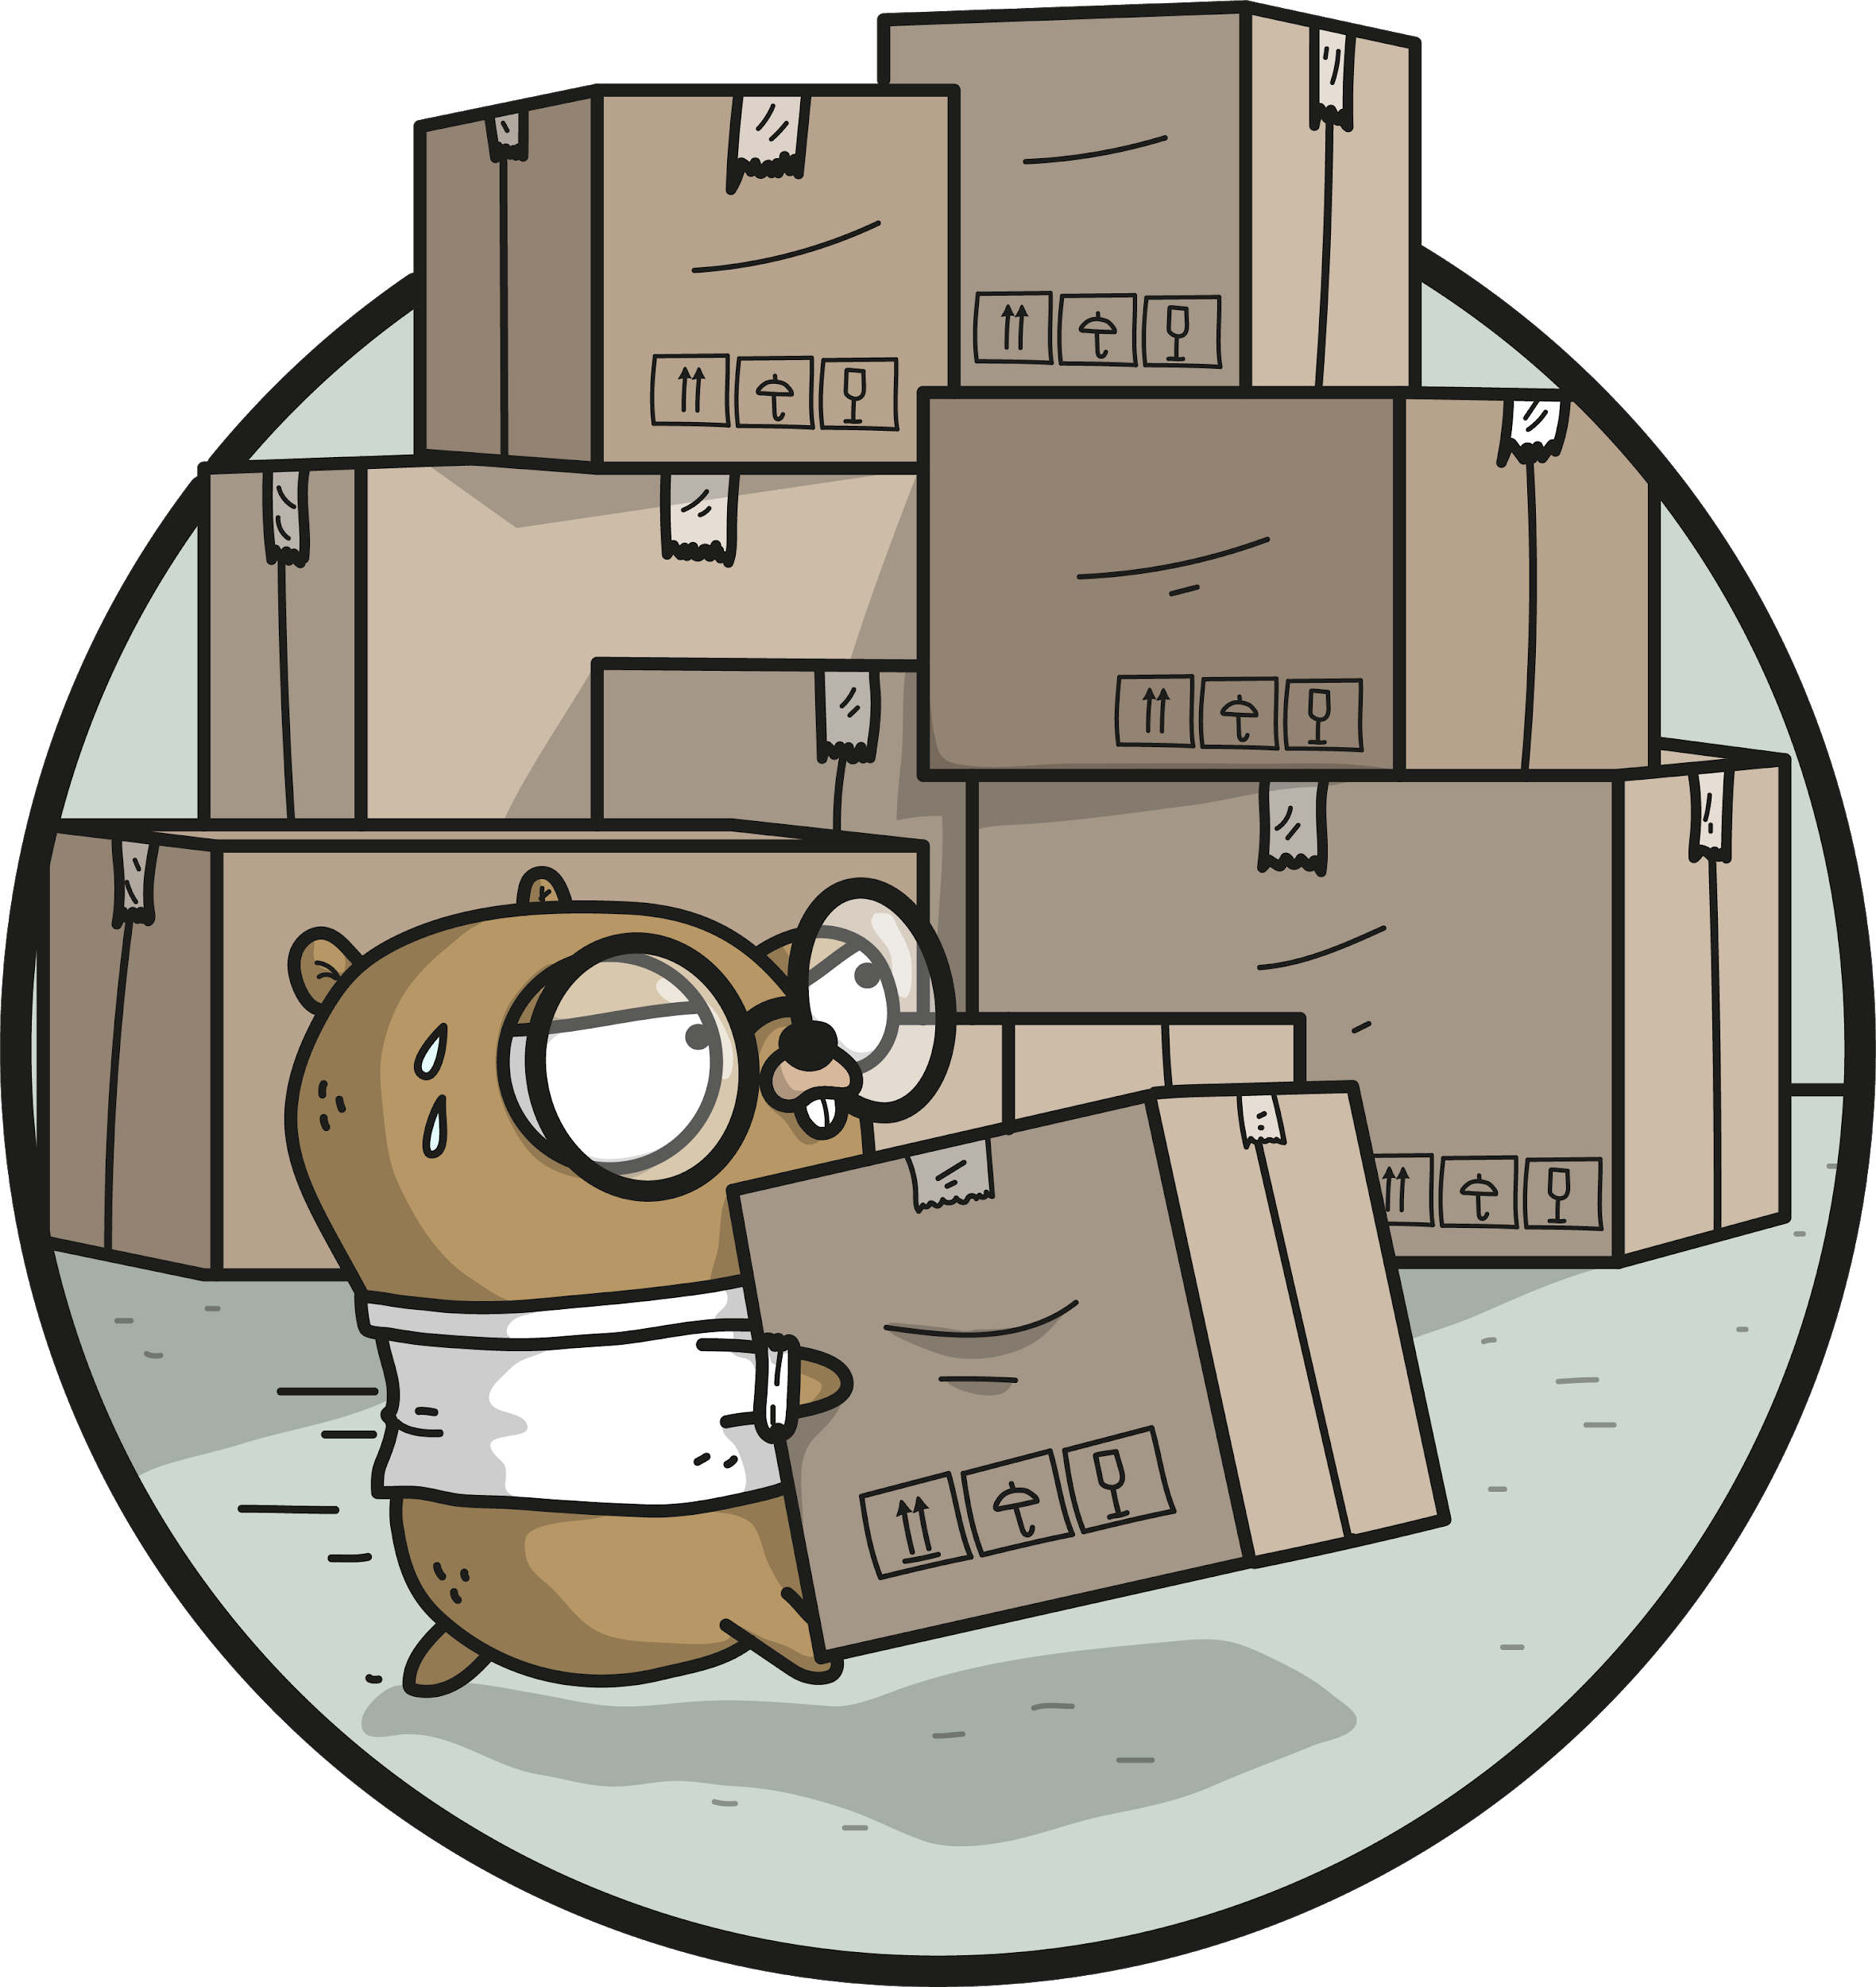
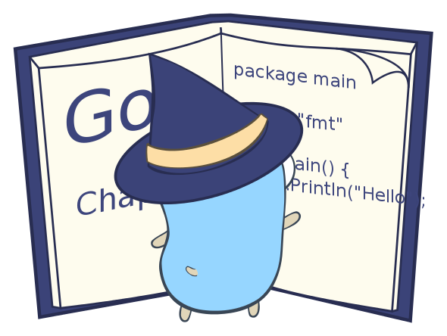



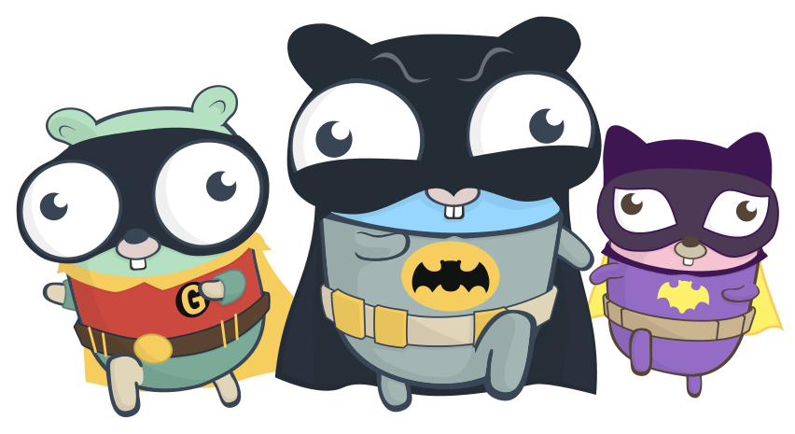

Modern
Interoperability
Garbage Collected
Lightweight Syntax
Strictly Typed
Concurrent
Fast
Cross Platform
Notes:
Garbage Collected - automatically clear unused heap allocations, in c/c++ does not have automatic garbage collection
Modern - one loop method “for” , No OOP concepts, suitable for modern architectures and patterns
Interoperability - integrate with any language into go using standard cgo library
Lightweight Syntax - removed unnecessary parentheses, less number of keywords,
Fast - C like performance,
Concurrent - other languages have threads, but we have goroutines , by design its concurrency supported
Strictly typed - enforce typing on all data being interacted with
Cross Platform - it does not matter where you code, It can compiled to any platform
Google - It is designed by experts and backed by google
Multicore CPU architecture support by design
Memory managed,
Statically typed
Excellent concurrency
Perfect for simple,small and network services

Slide 5

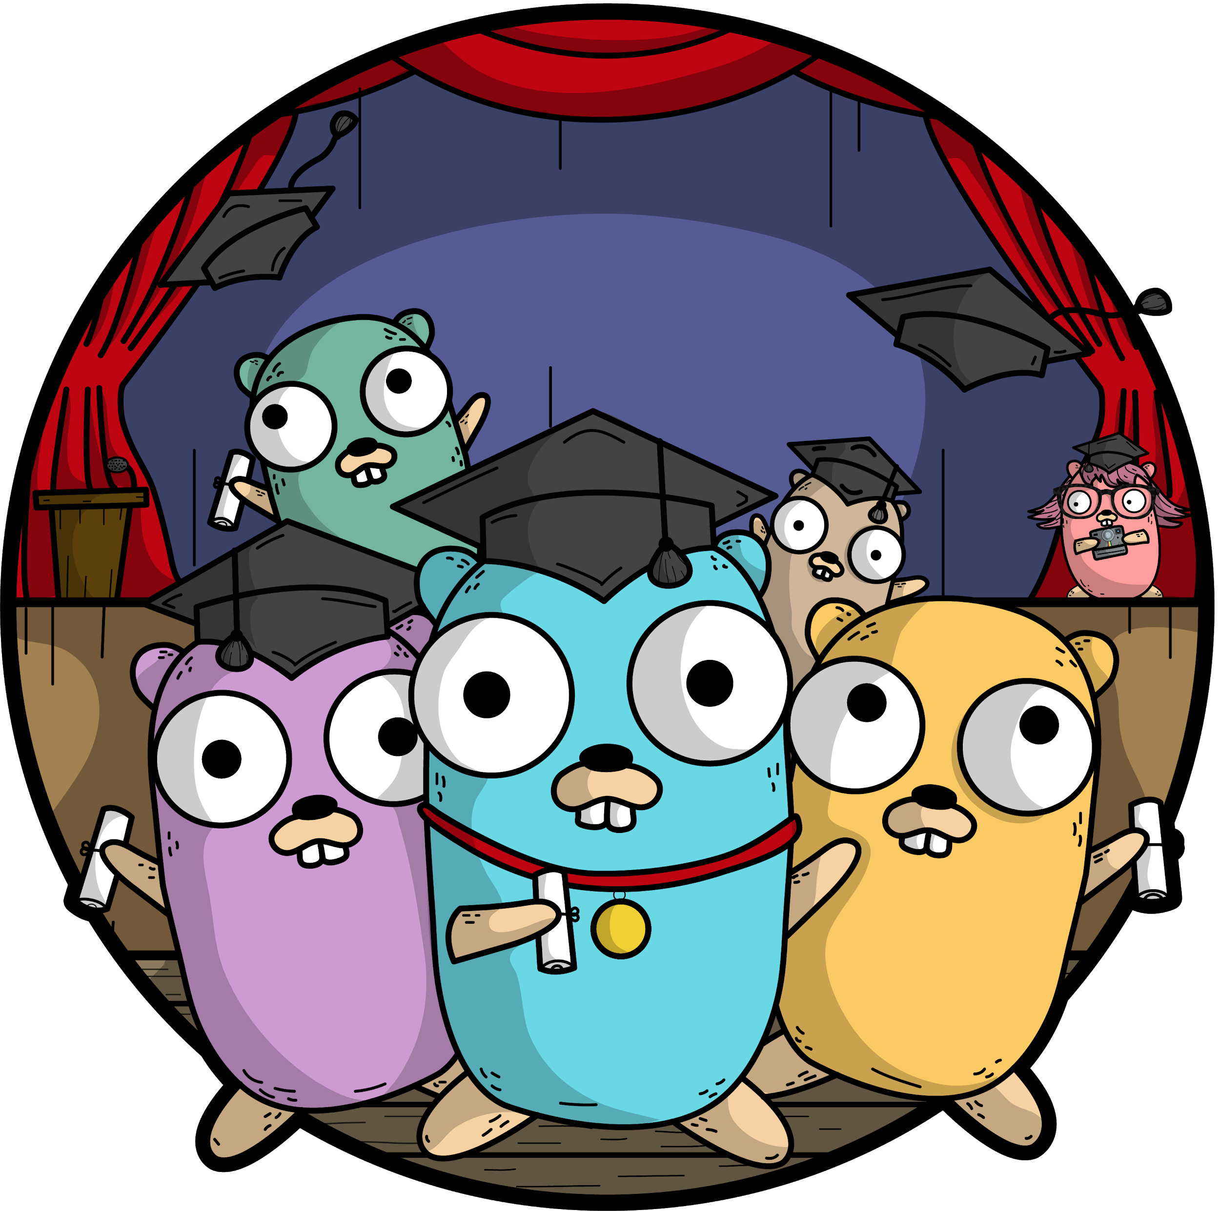
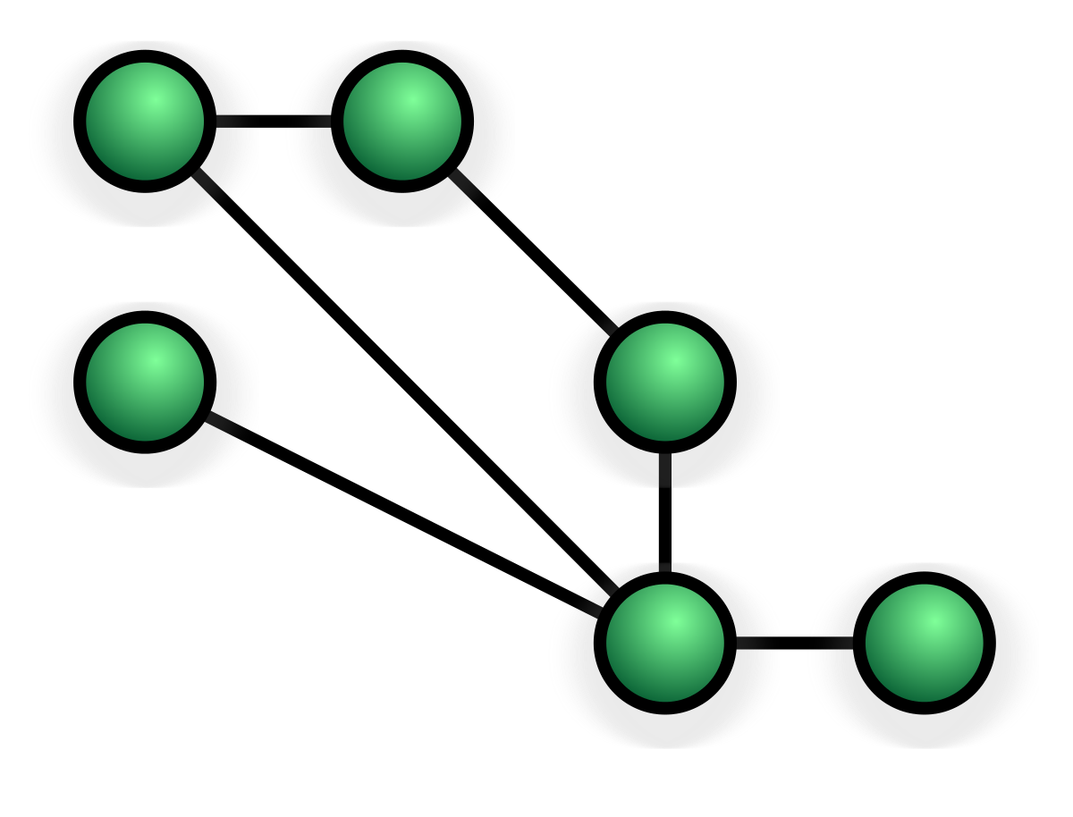

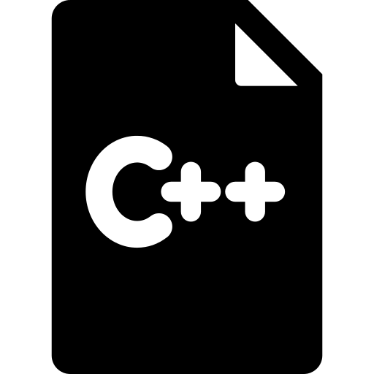




Distributed Systems
Fast Compilation
Matured
Multicore
Complexity, Weight
No Static Checking
Notes:
Matured - It's been 10 years since the first release, 2009 November 10 first appeared, initial release 1.0.3 2012, 1.13.3 latest release
Distributed Systems - portability, built in high performant feature rich net package support, pool package which will explain later
Multicore - by design it’s able run in multicore systems
Fast Compilation - compiler is written in go, only milliseconds to compile
First Class functions - where we can define functions as variables, that will give you a lots of flexibility

Slide 6
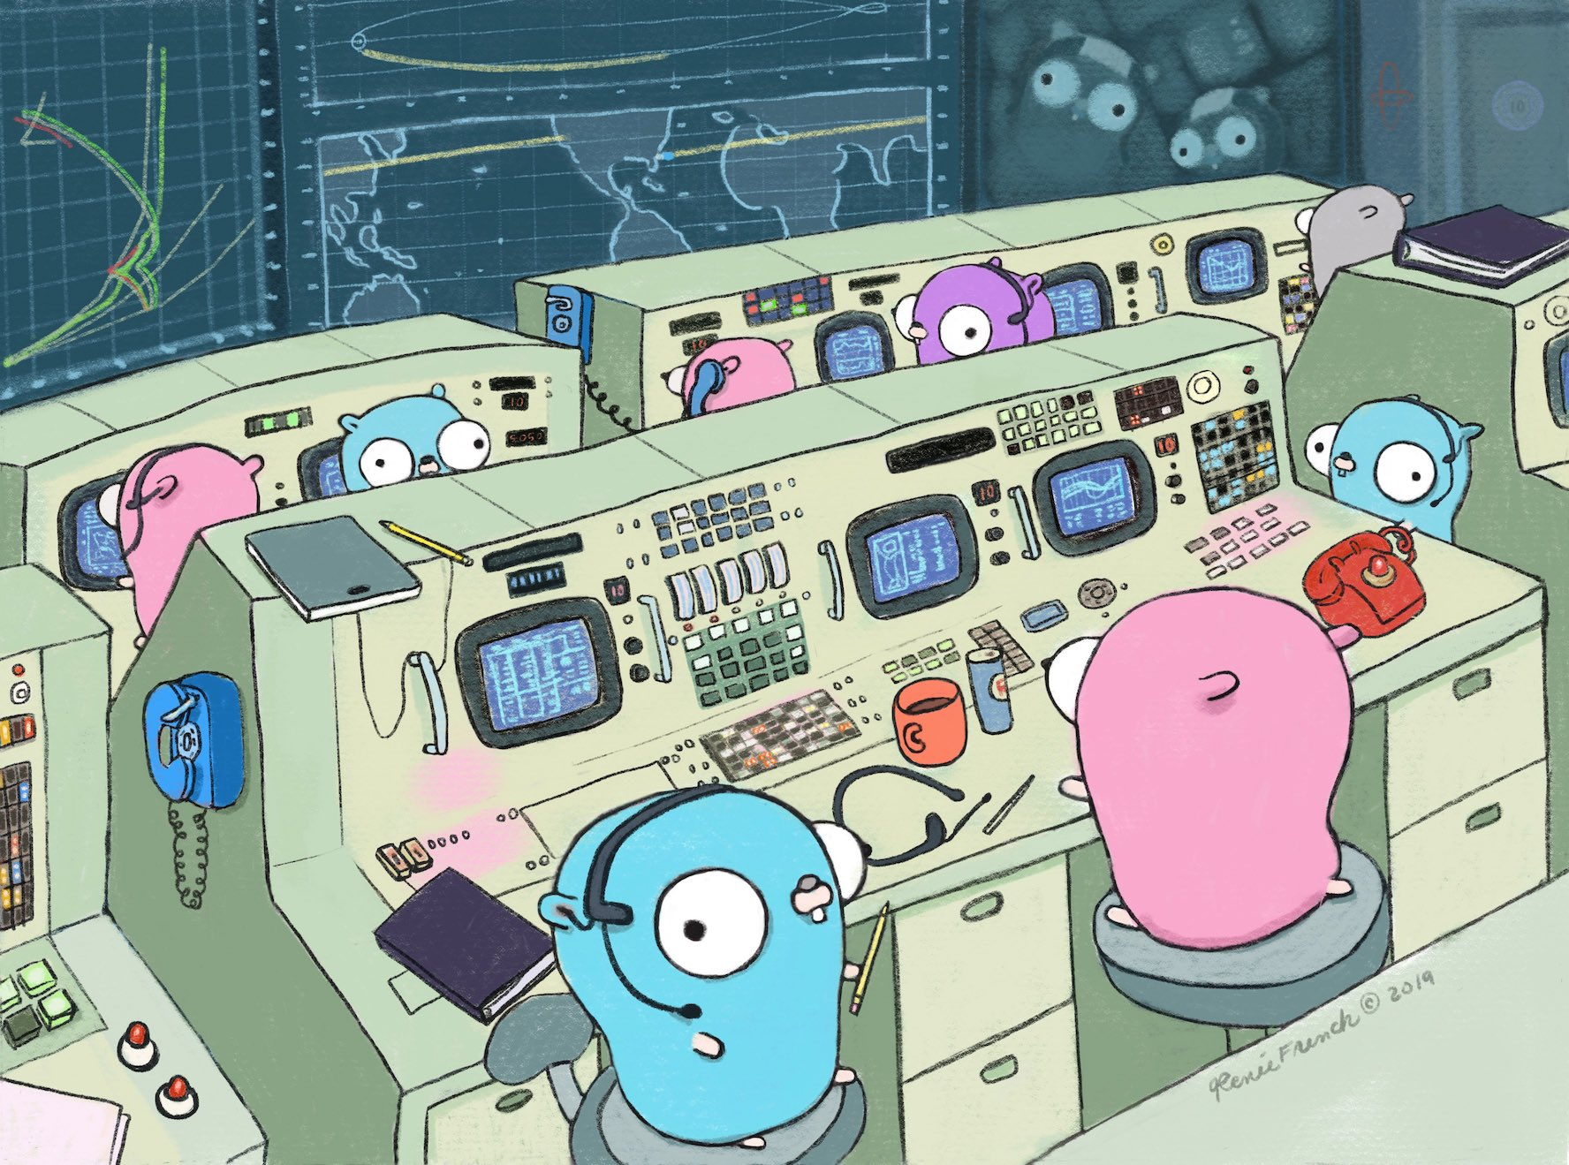
Notes:
It’s 10 years

Slide 7

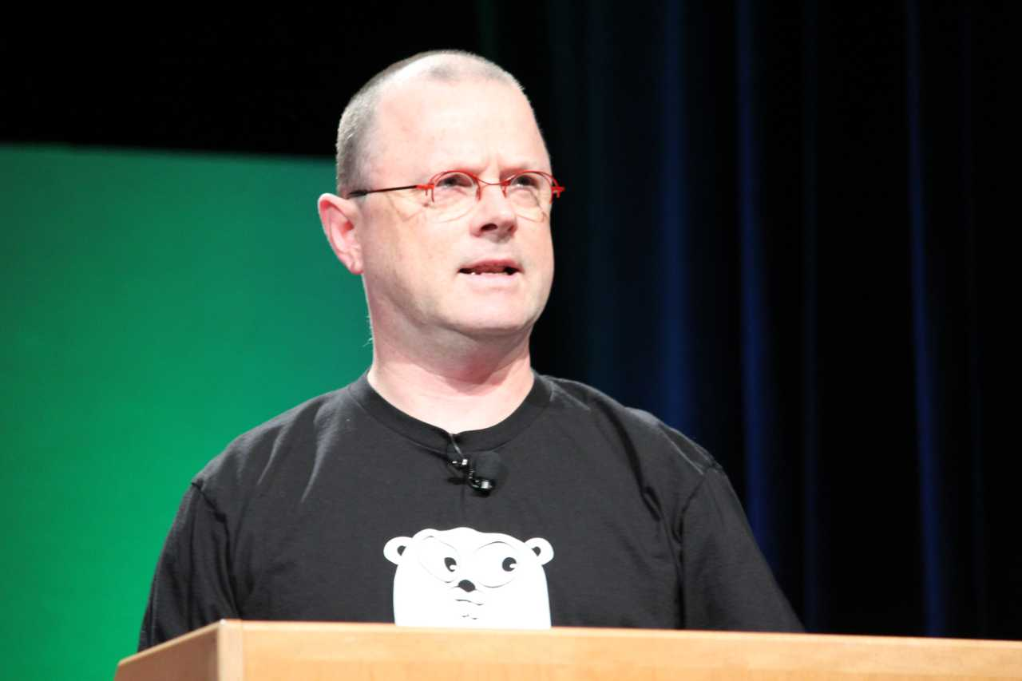
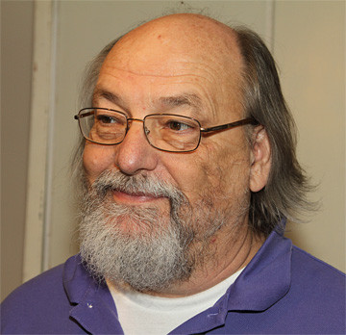
Who?
Robert Griesemer
V8 javascript engine, Java Hotspot VM
Rob Pike
Unix, plan9,UTF-8
Ken Thompson
Unix, plan9, B language, UTF-8

Slide 8




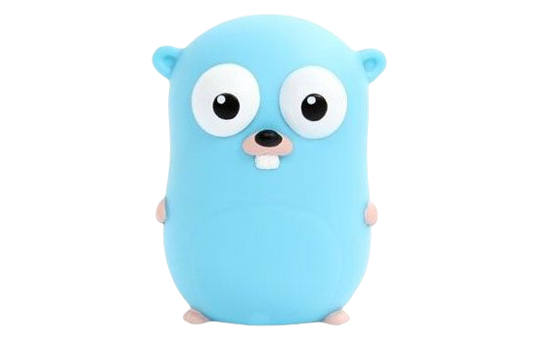



Journey from Zero to Hero
Application standardization
REST APIs
Basics of GO
Testing and Benchmarking
Monitoring with Prometheus and Grafana
Persist data
in MySQL
Application Profiling

Slide 9

Playing with GoLang
https://play.golang.org/

Slide 10

Installation
Wget https://dl.google.com/go/go1.12.13.linux-amd64.tar.gz
tar -C /usr/local -xzf go1.12.13.linux-amd64.tar.gz
export PATH=$PATH:/usr/local/go/bin

Slide 11



Starting Development With Go
IDEs
VS Code
GoLand
Hello World Program
Run
Compilation
Notes:
Hello world application

Slide 12
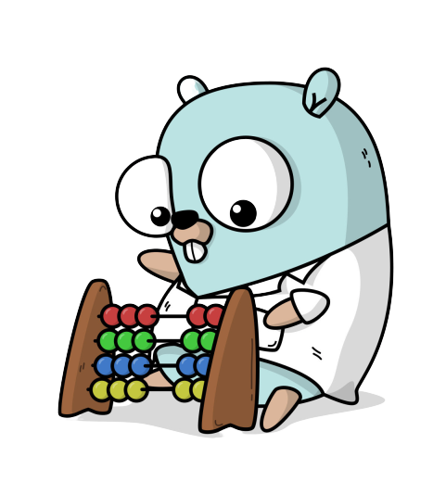
Basic Go Understanding
https://gobyexample.com/

Slide 13
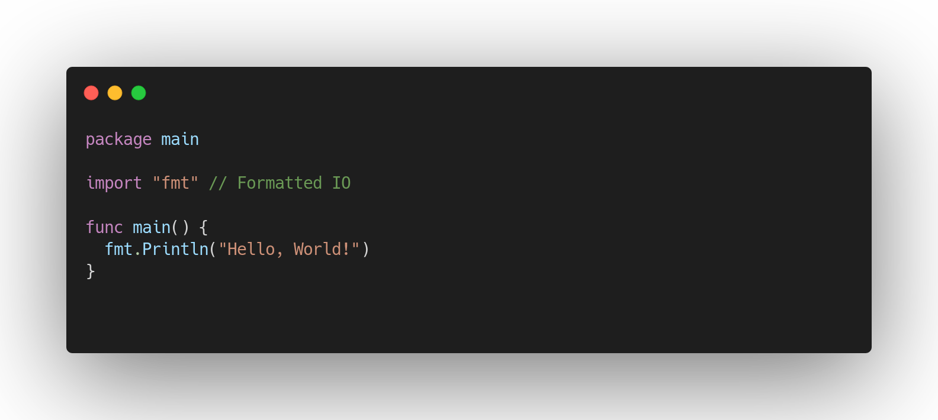
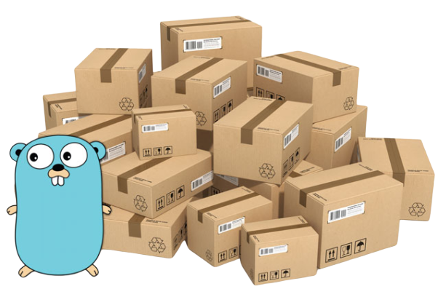
Packages
Notes:
Executable packages must have main package and a main function which is the starting point of the appication,
Package name maybe different from the folder name
Package naming standards
What will happen when we have a different package name in a folder (not the folder name)

Slide 14
Types
int, int8, int32, int64
uint8,uint16,uint32,uint64
byte (uint8)
float32, float64
string
rune (int32)
boolean
uintptr
nil
Arrays
Slices
Maps
Channels
Interfaces
Notes:
Available data type

Slide 15




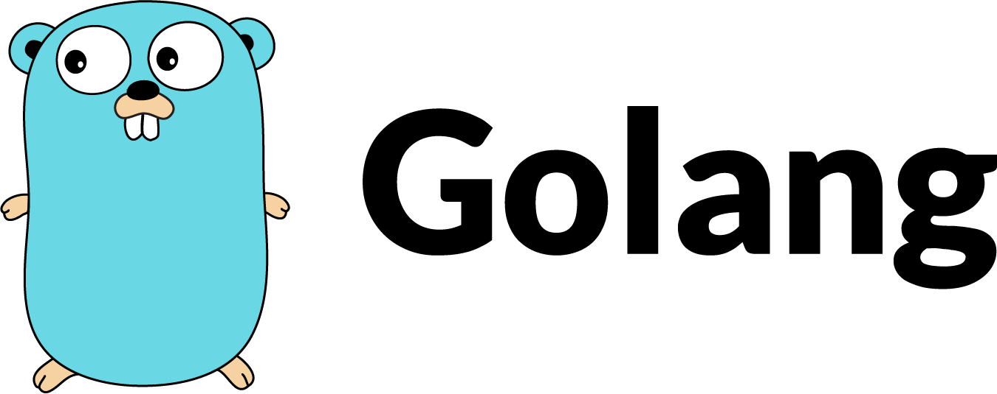
Keywords?
Notes:
Java - 48
Javascript - more than 50
C++ - More than 70
Python - 33

Slide 16
Keywords
break | default | func | interface | select
case | defer | go | map | struct
chan | else | goto | package | switch
const | fallthrough | if | range | type
continue | for | import | return | var
Notes:
On the go we will explain all these keywords

Slide 17
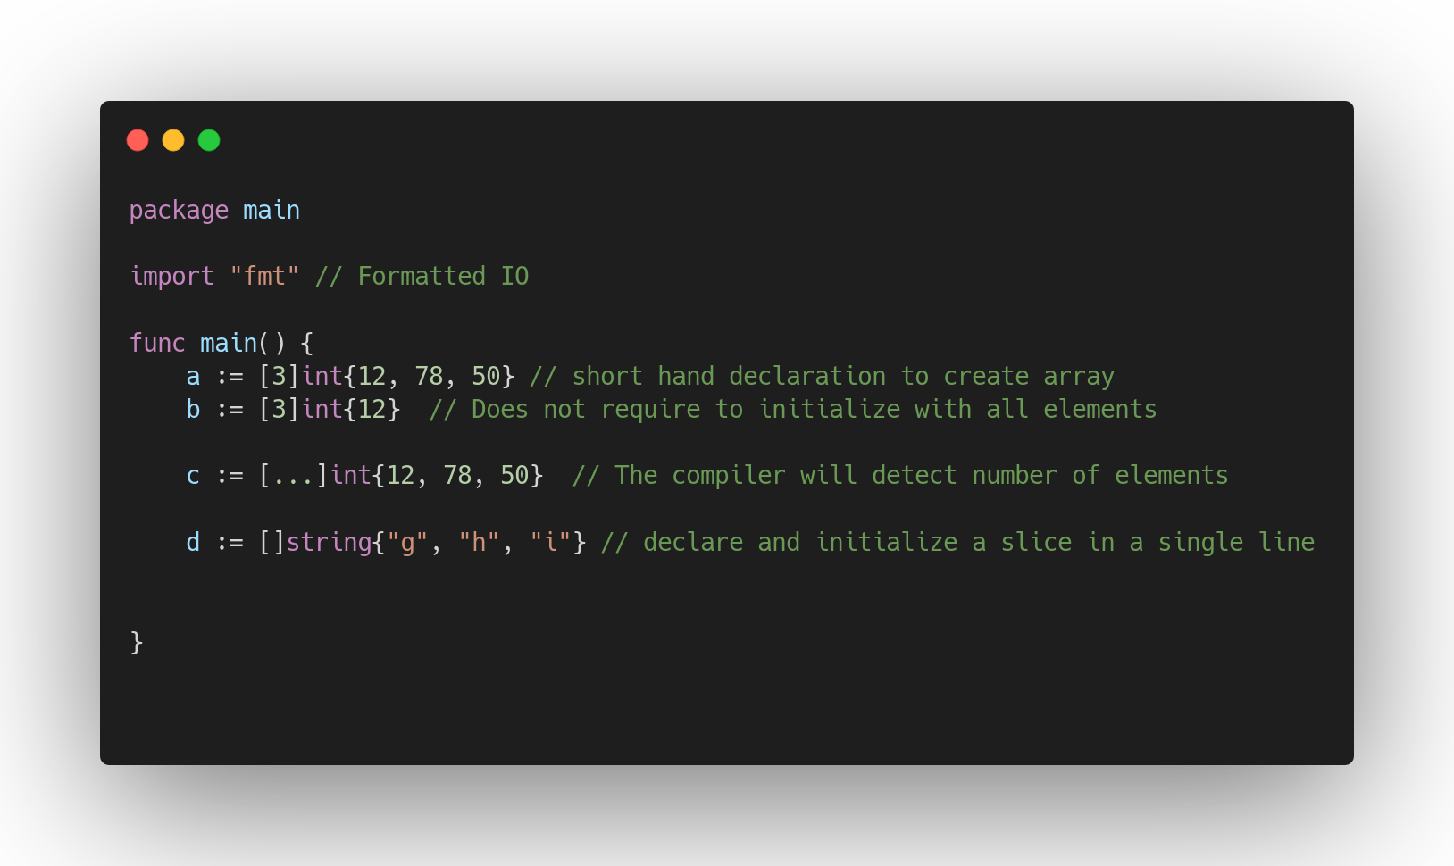
Arrays and Slices
Notes:
Arrays are getting created in the stack, So we get better performance.
The size of the array is a part of the type.
Arrays are value types
Arrays has a fixed size
Slices are created in the heap, Flexible

Slide 18
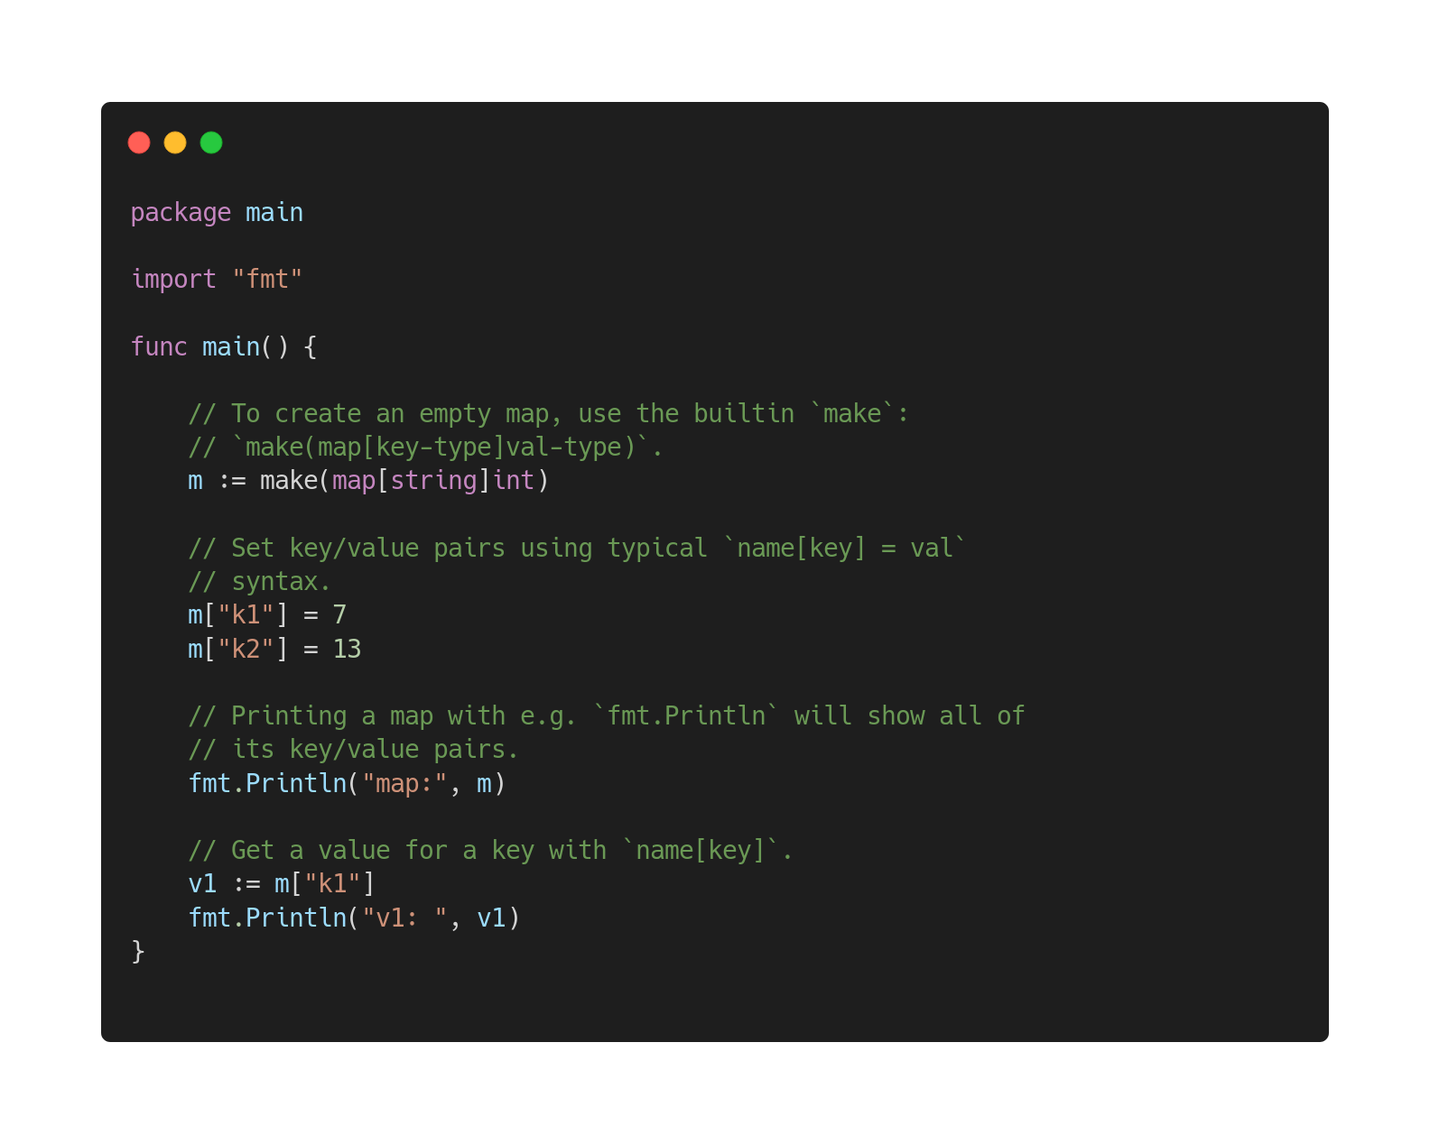
Maps
Notes:
Maps are really useful when you need high performing key-value lookups
Passed by reference
Not concurrency safe

Slide 19
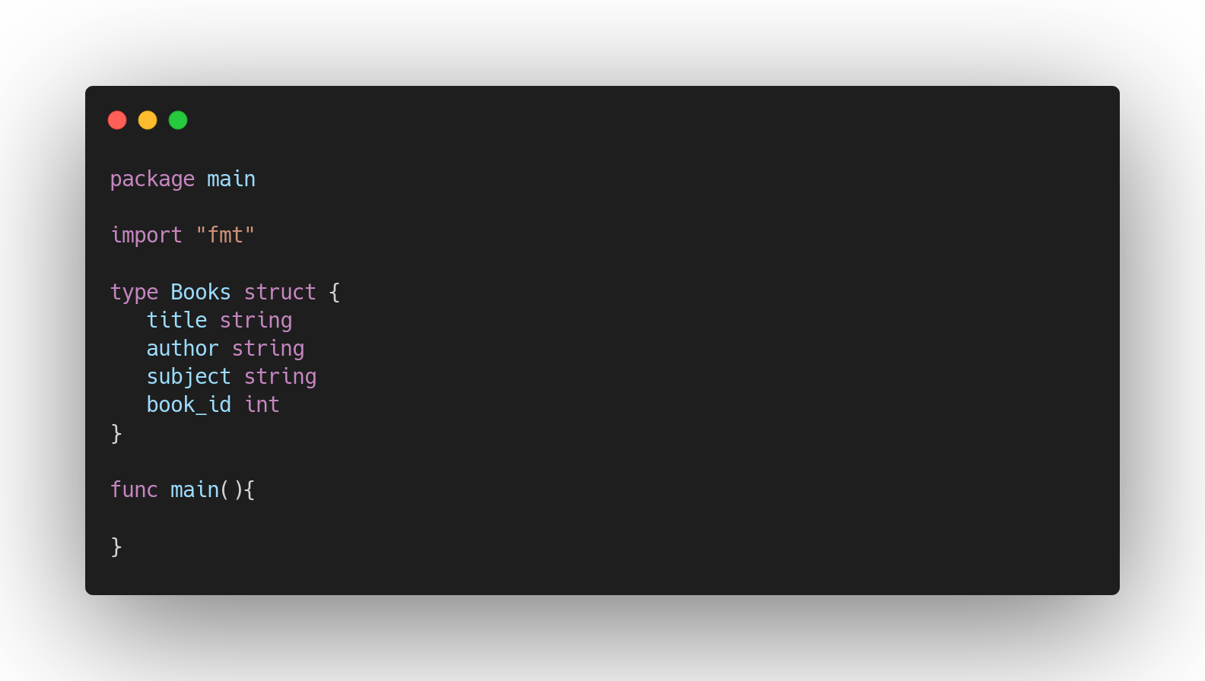
Structures
Notes:
Structures are created composing other types
Allocation of Empty structures is zero

Slide 20
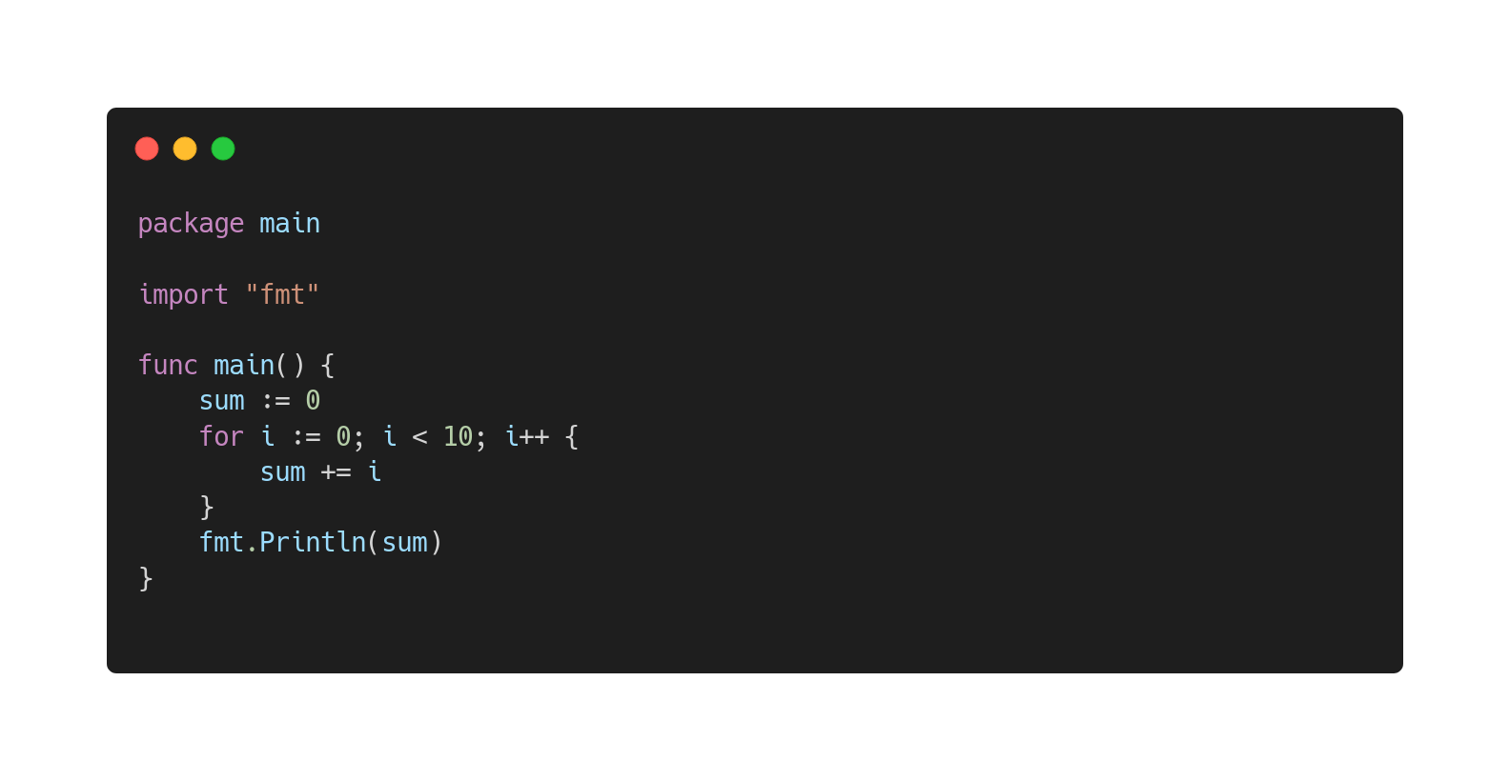
Loops
Notes:
Only for is available
Range keyword

Slide 21
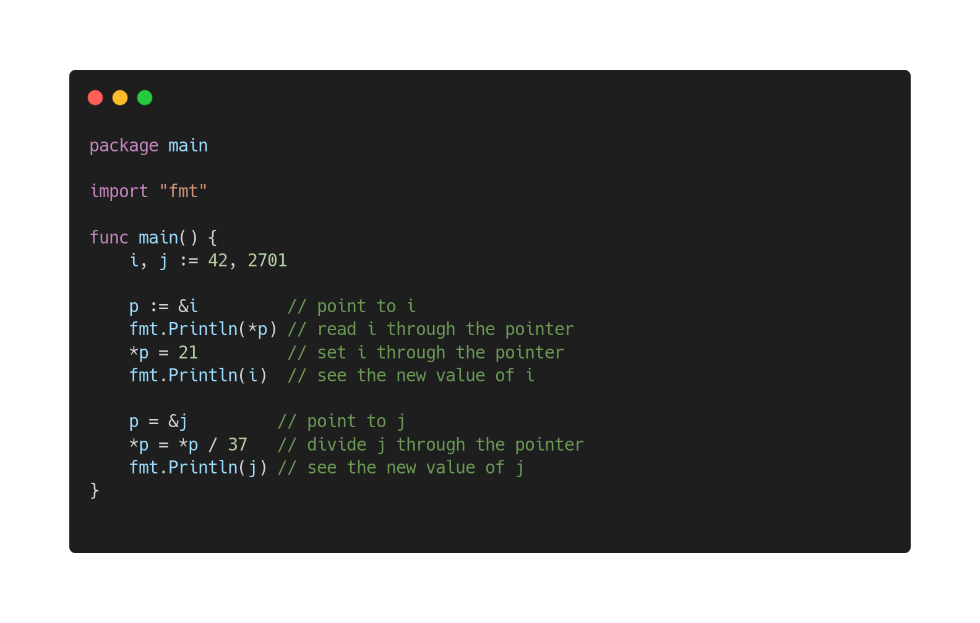
Pointers
Notes:
No pointer arithmetics,
Pointers can be used to pass large memory objects efficiently

Slide 22
Functions and Methods

Slide 23
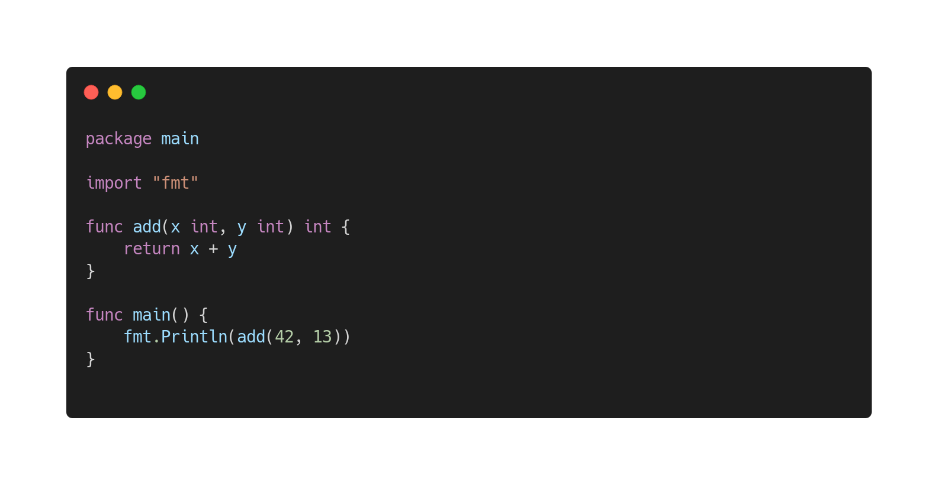
Functions
Notes:
Functions are defined starting with func keyword

Slide 24
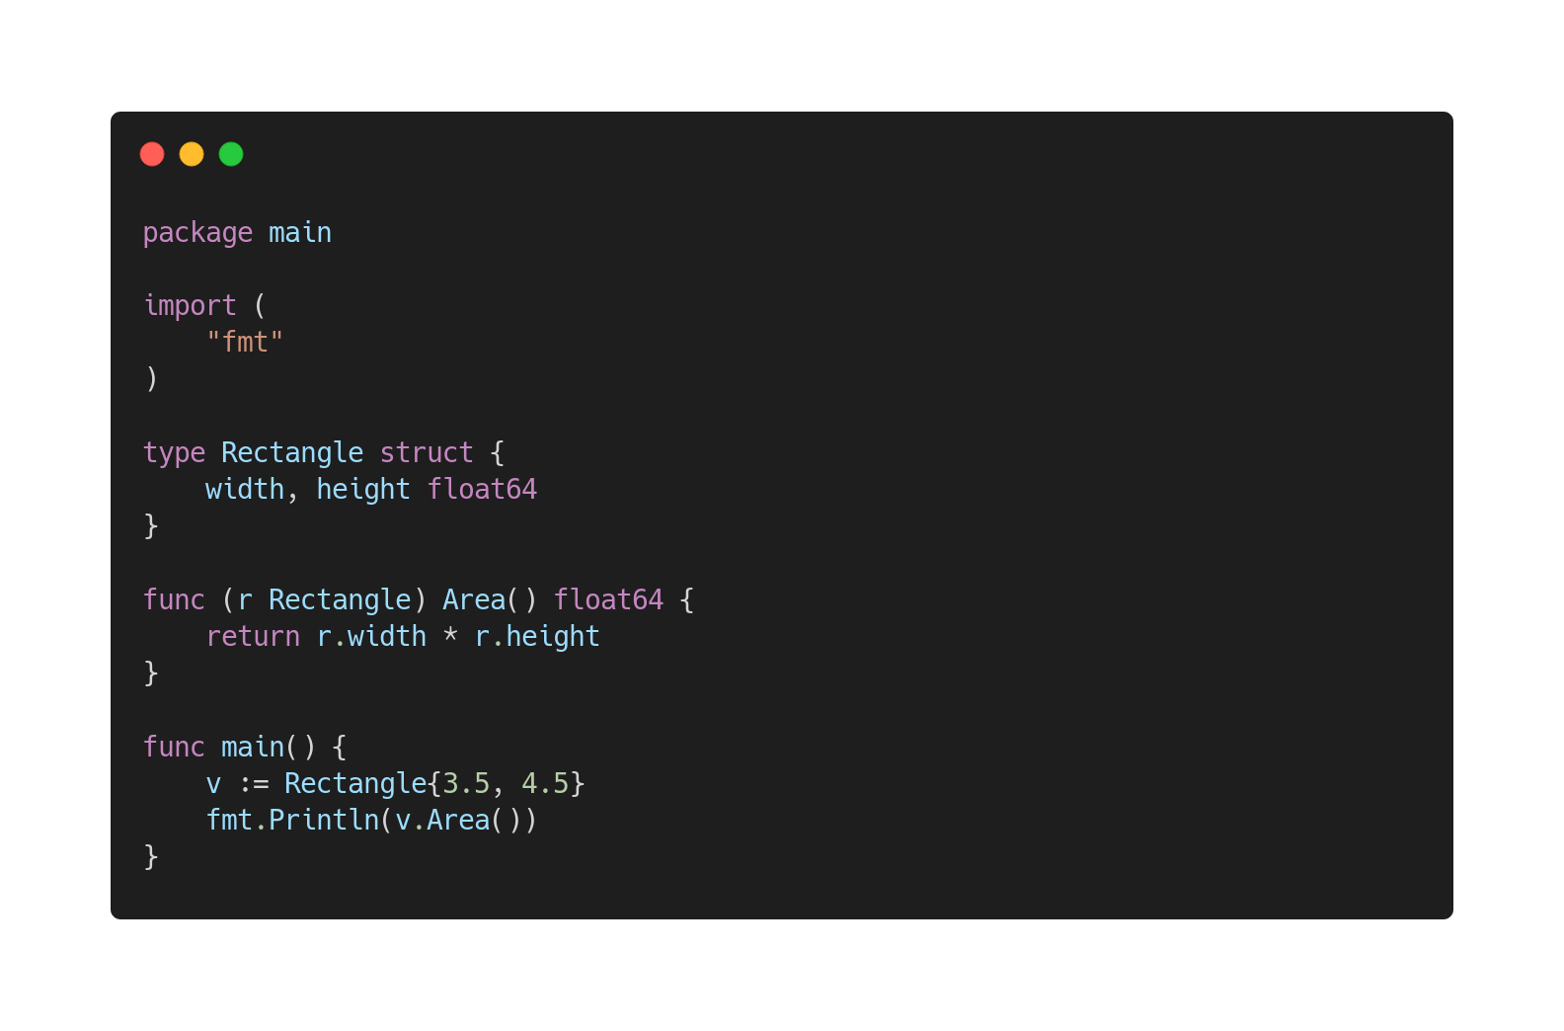
Methods
Notes:
Pointer receiver and value receivers are available,

Slide 25
Conditions
if / else
Switch case

Slide 26
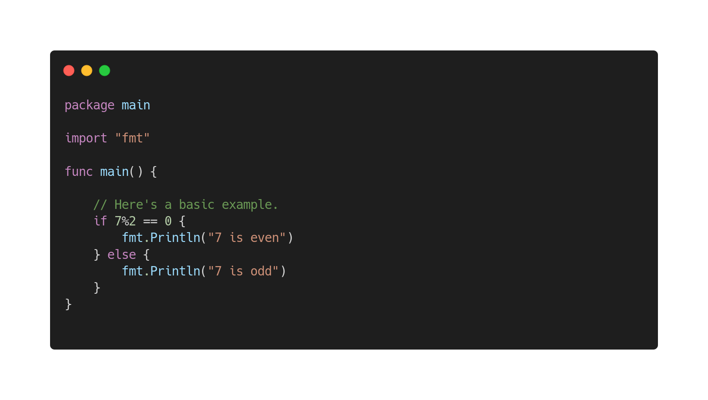
If/ Else
Notes:
Im not going to explain this

Slide 27
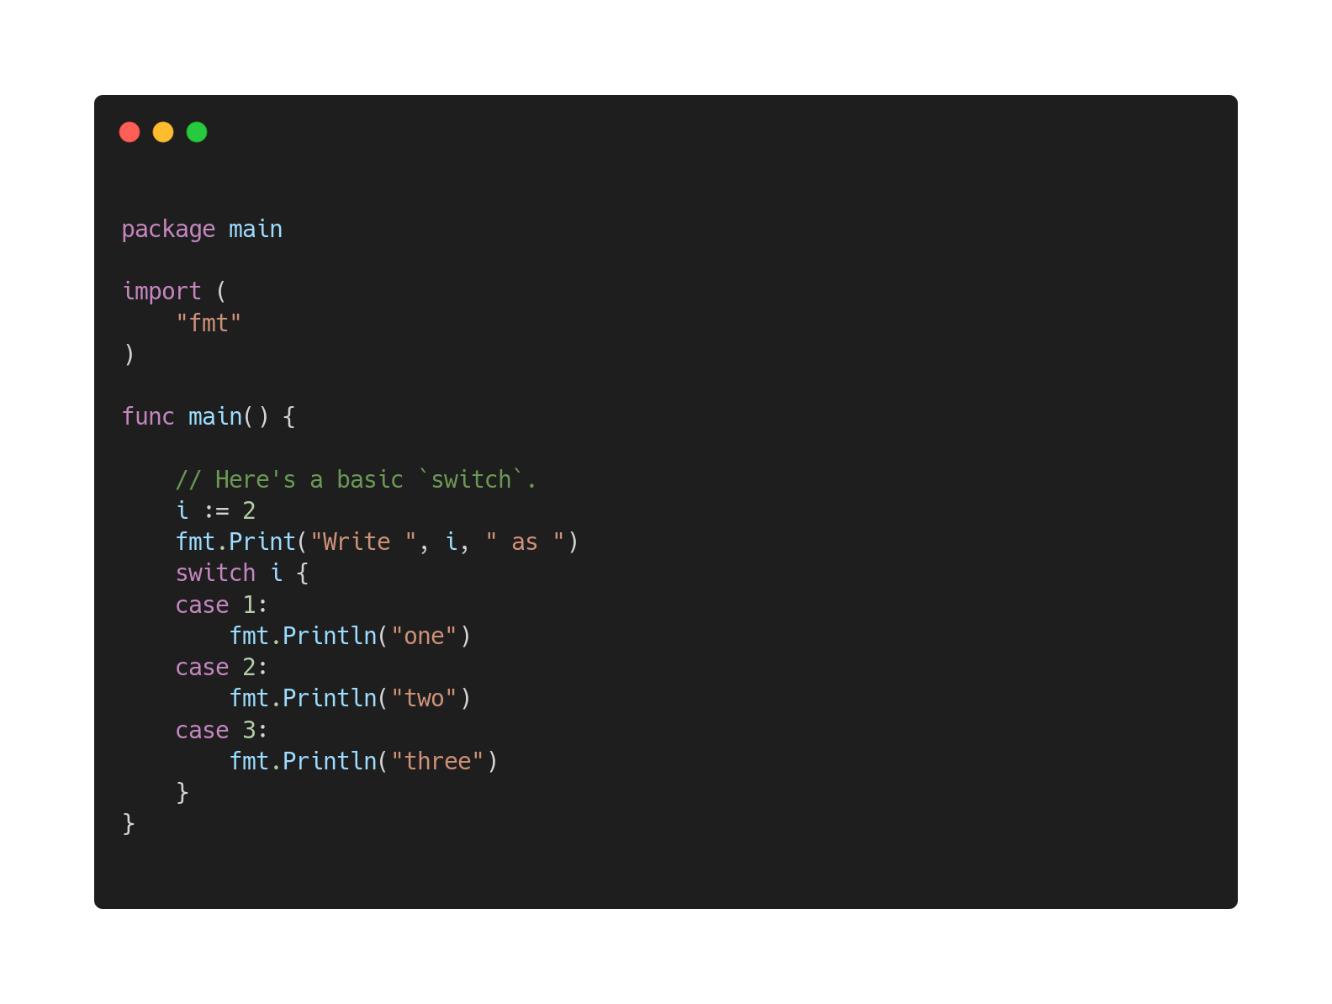
Switch Case
Notes:
Explain fallthrough

Slide 28
Let’s say “Hello, World”
Simple Hello, World app
Hello world with simple HTTP response
HTTP Server with Handler
Server Mux Implementation

Slide 29
Session 2
1.5 Hours

Slide 30
CRUD application with in-memory storage
Will be extend this by integrating a persistent database

Slide 31
REST API
<endpoint>/person POST
<endpoint>/person GET
<endpoint>/person/:id GET
<endpoint>/person/:id PUT
<endpoint>/person/:id DELETE
Notes:
REST - representational state transfe
GET - Retrieve data
POST - Add Data
PUT - Update Data
DELETE - Delete data

Slide 32

Clone the source
https://github.com/devfest2k19/gowork.git

Slide 33

Dependency Management
How to use go mod?
Notes:
A module is a collection of related Go packages that are versioned together as a single unit.

Slide 34
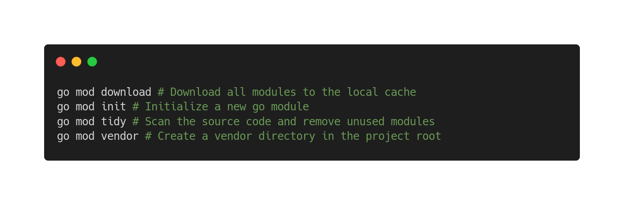
Basic Go mod commands
Notes:
Order

Slide 35
Persisting Data

Slide 36
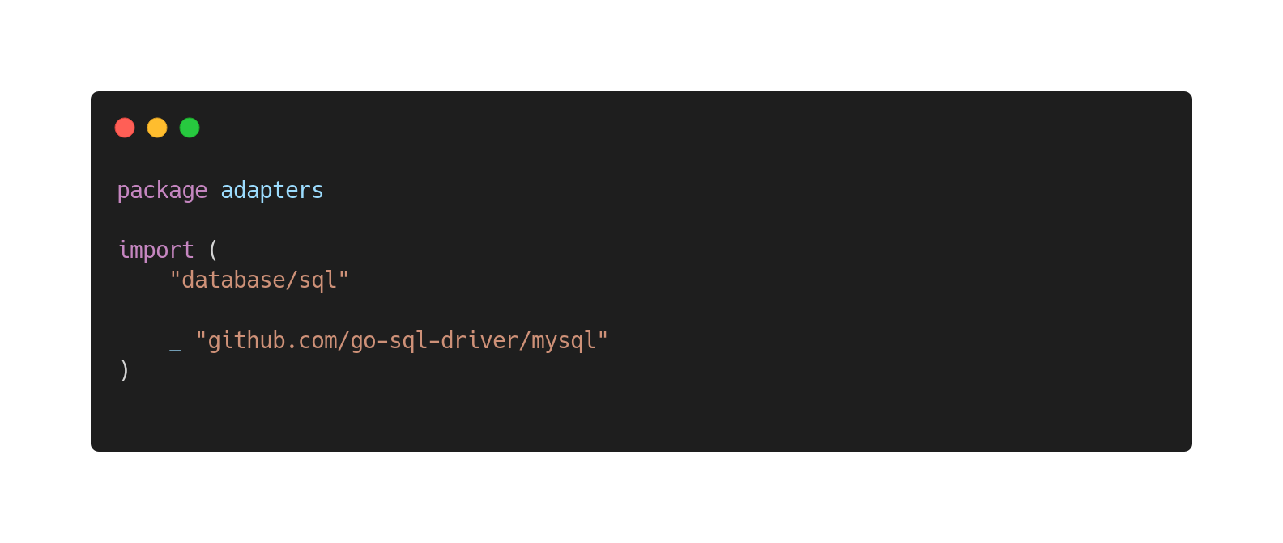
Database Integration
The database/sql package provides a generic interface around SQL (or SQL-like) databases.
The sql package must be used in conjunction with a database driver.
Ex: MySQL, PostgreSQL
Notes:
The database/sql package provides a generic interface around SQL (or SQL-like) databases.
It provides a lightweight interface to a row-oriented database
The sql package must be used in conjunction with a database driver.
sql.NullString
Ex: MySQL, PostgreSQL
We use the rows.Scan() method to copy the values from each field in the row to a new variable

Slide 37
Database Credentials
IP: 35.213.163.65
Port: 3306
User : devfest_go
Pass: goturns10
DB: phonebook
Notes:
devfest_go:goturns10@tcp(35.213.163.65:3306)/phonebook

Slide 38
Session 3
2 Hours

Slide 39

Unit testing in Go

Slide 40
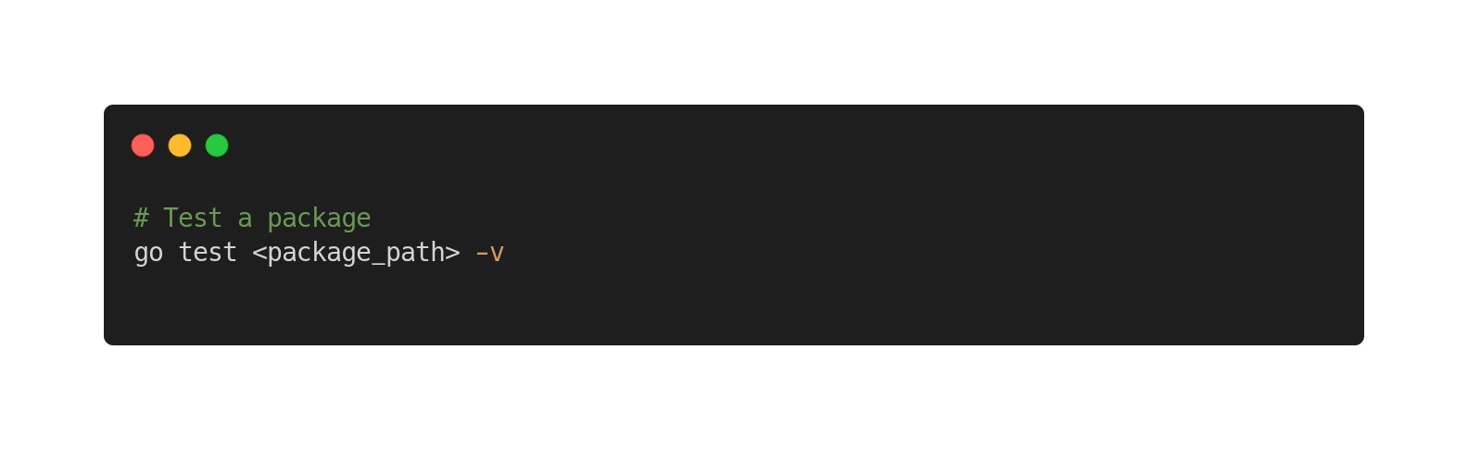
How to run unit tests?

Slide 41
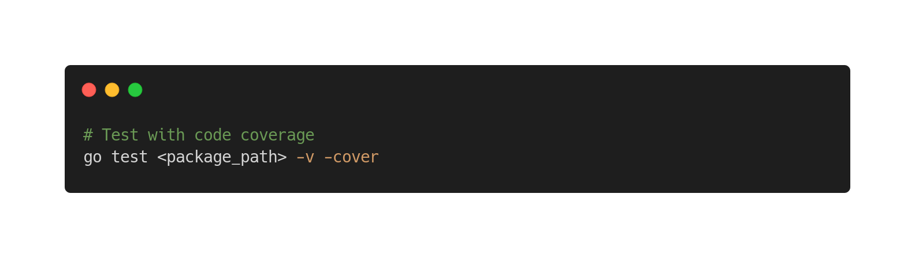
Code Coverage

Slide 42
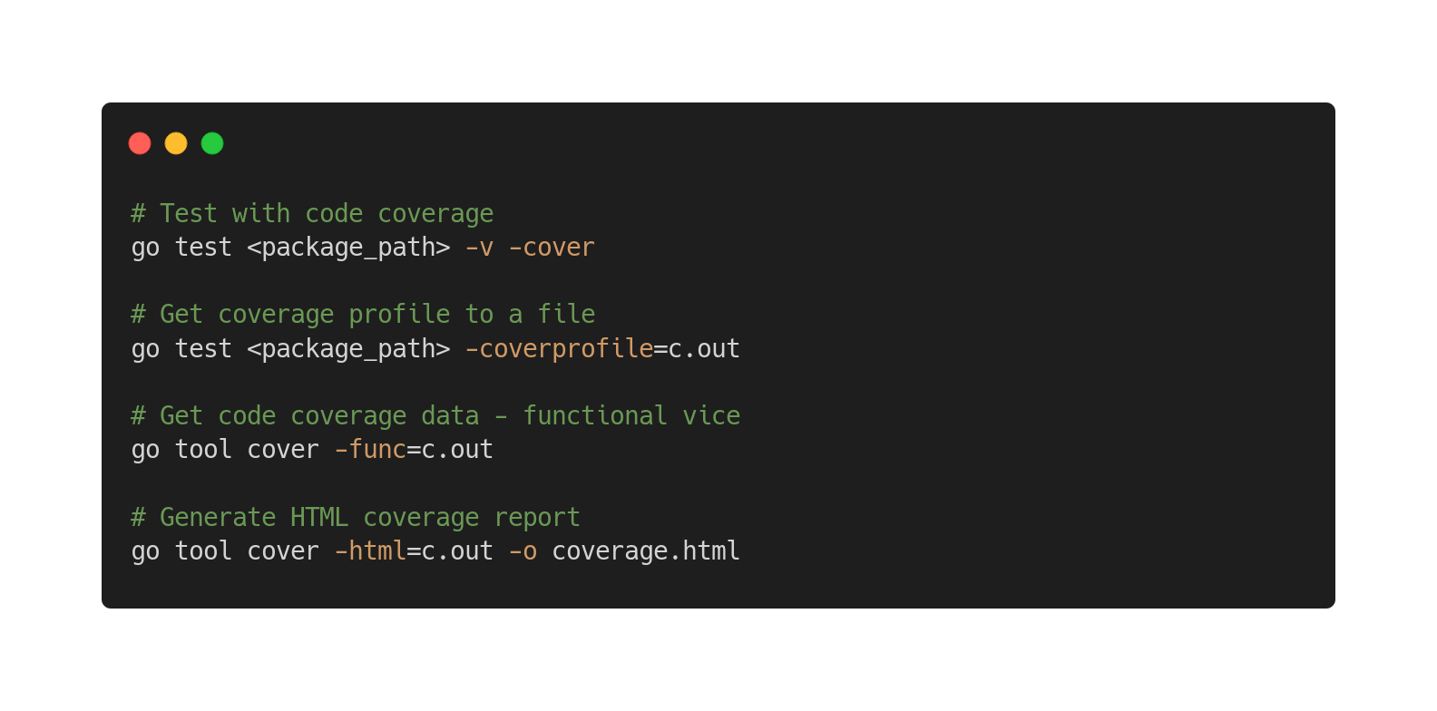
Code Coverage tools
Notes:
Go cover tool

Slide 43

Benchmarking in GO

Slide 44
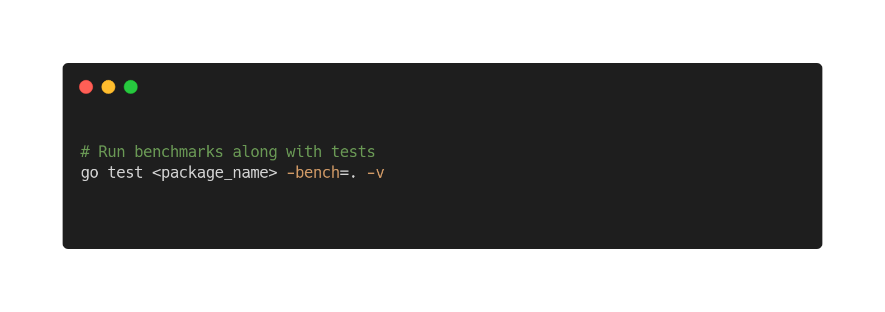
How to run benchmarks?

Slide 45

Log Standardization
github.com/pickme-go/log

Slide 46


Application Monitoring
Prometheus/ Grafana
Instrumenting the application

Slide 47
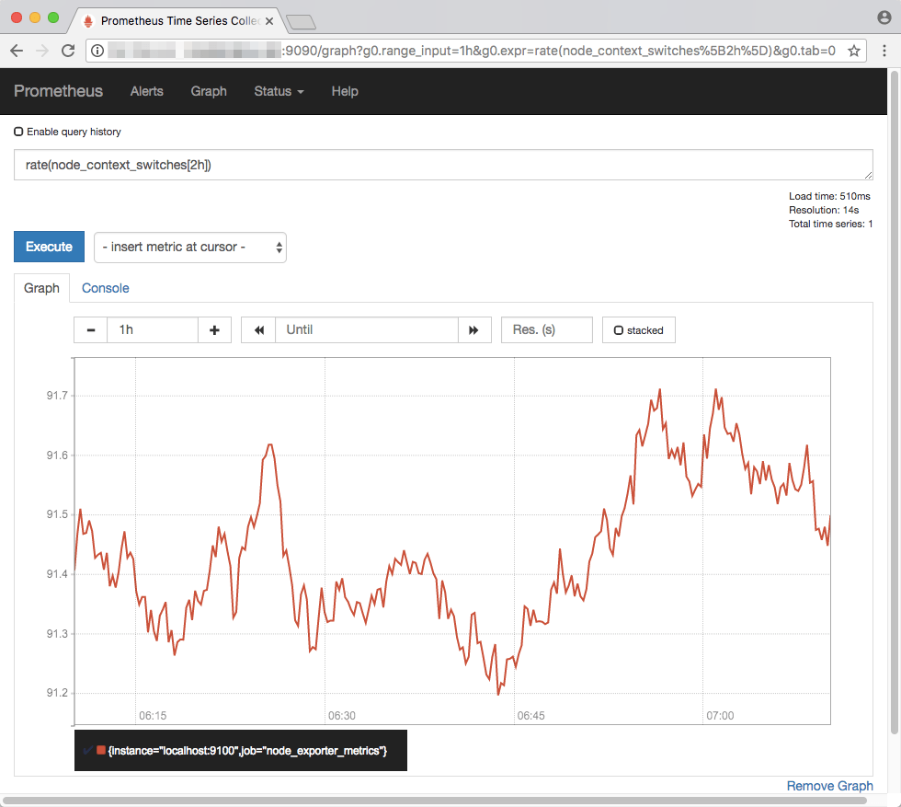
Install Prometheus
Install prometheus in Ubuntu
wget https://github.com/prometheus/prometheus/releases/download/v2.14.0/prometheus-2.14.0.linux-amd64.tar.gz
tar xvfz prometheus-2.14.0.linux-amd64.tar.gz
cd prometheus-2.14.0.linux-amd64
vim prometheus.yml
#####---- insert your job details ----#####
- job_name: 'dev-fest-crud'
static_configs:
- targets: ['localhost:8001']
#####---------------------------------#####
sudo ./prometheus

Slide 48
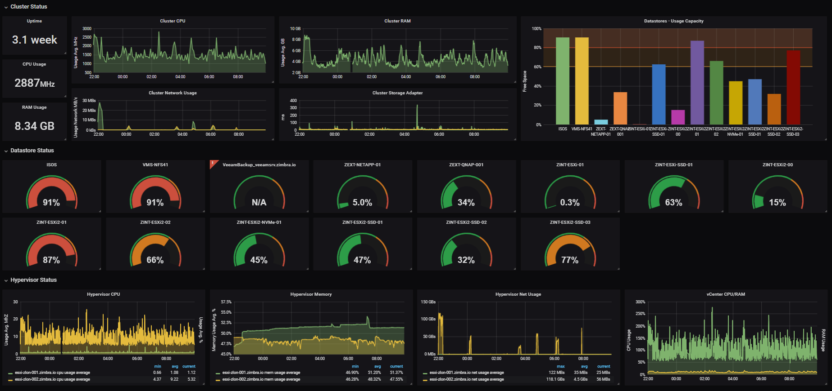
Install Grafana
Install grafana in Ubuntu
wget https://dl.grafana.com/oss/release/grafana-6.4.4.linux-amd64.tar.gz
tar -zxvf grafana-6.4.4.linux-amd64.tar.gz
bin/grafana-server

Slide 49
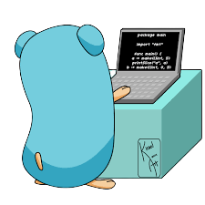
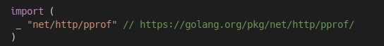
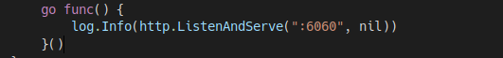
Application Profiling
Use of go pprof package

Slide 50
Concurrency
Goroutines
Go channels
Sync package

Slide 51

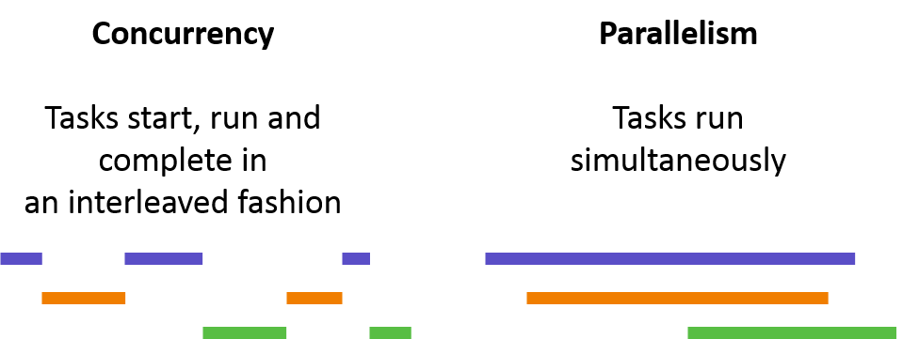



Concurrency & parallelism
Concurrency is not parallelism
“Concurrency is about dealing with lots of
things at once. Parallelism is about doing
lots of things at once.” — Rob Pike

Slide 52
Concurrency applied
Design our program as a collection of independent processes
Design these processes eventually run in parallel
Design our code so that the outcome is always the same.

Slide 53
Go’s Concurrency Tool Set
Goroutines
Channels provide a way for goroutines to communicate with one another and synchronize their execution.
Channels
In Go, concurrency is achieved by using Goroutines. Goroutines are functions or methods which can run concurrently with others methods and functions.
Select
Like switch case. Select can listen to multiple channels and execute first one triggered.
Sync package
Handle waiting for goroutines and mutex locking

Slide 54
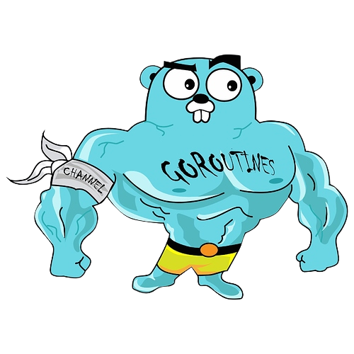
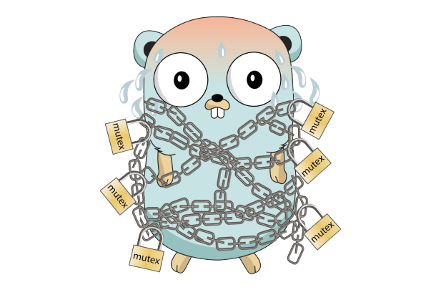
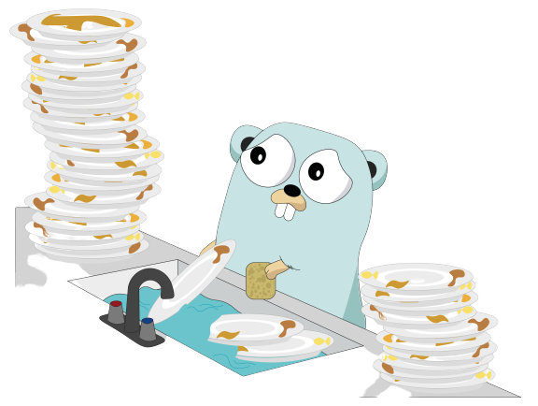



Goroutines vs Threads
Growable segmented stacks
Faster startup time
Built in primitives for safe communication
Avoid resorting to mutexes
No 1:1 mapping with os threads
Higher concurrency with lesser complexity
Notes:
what are threads, what’s their job?
A thread is a light-weight process inside a process
A thread has access to memory provided by the process, OS resources, and other things
goroutines behave like threads but technically; it is an abstraction over threads
GOMAXPROCS
OS threads are managed by kernal and has hardware dependencies.
Threads have significant setup and teardown cost as a thread has to request lots of resources from OS and return once it's done.
Stack size is determined during compile time and can not grow for threads.
Stack size of go is managed in run-time and can grow up to 1GB which is possible by allocating and freeing heap storage
OS threads generally have fixed stack size of 1-2MB
goroutines typically have 8KB (2KB since Go 1.4) of stack size in newer versions of go

Slide 55
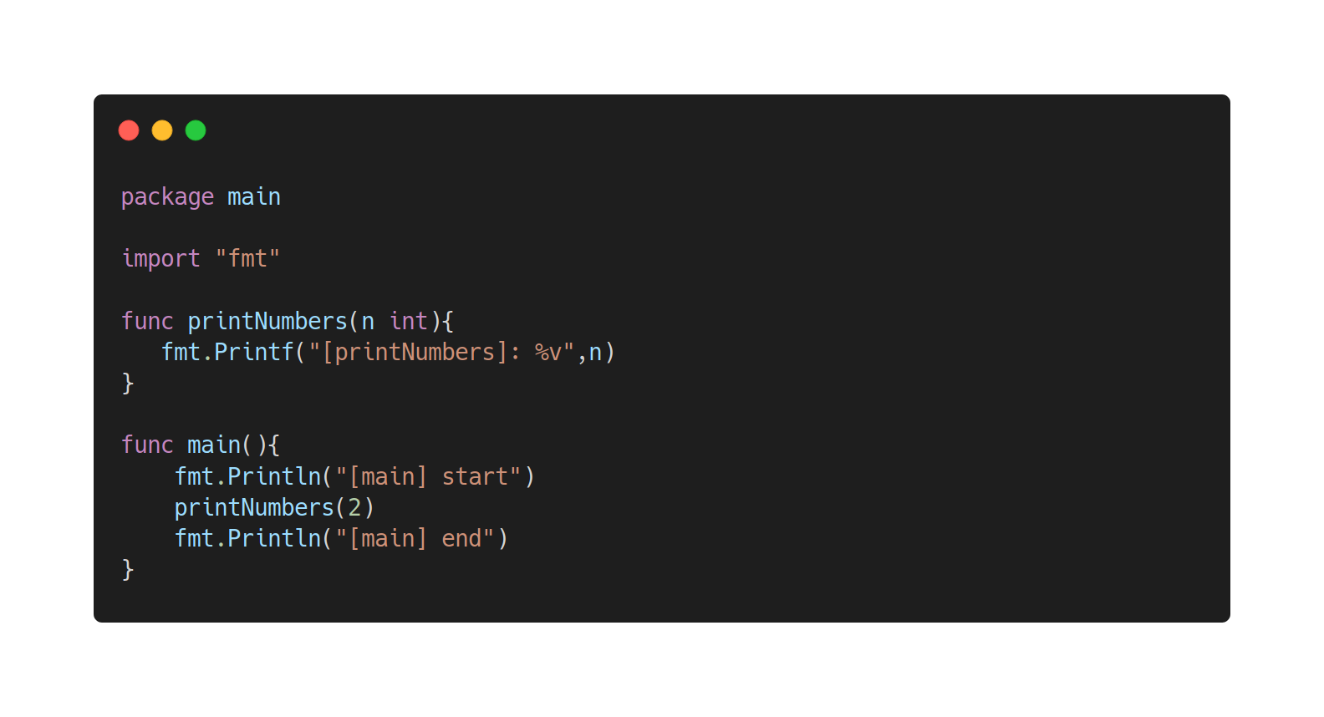

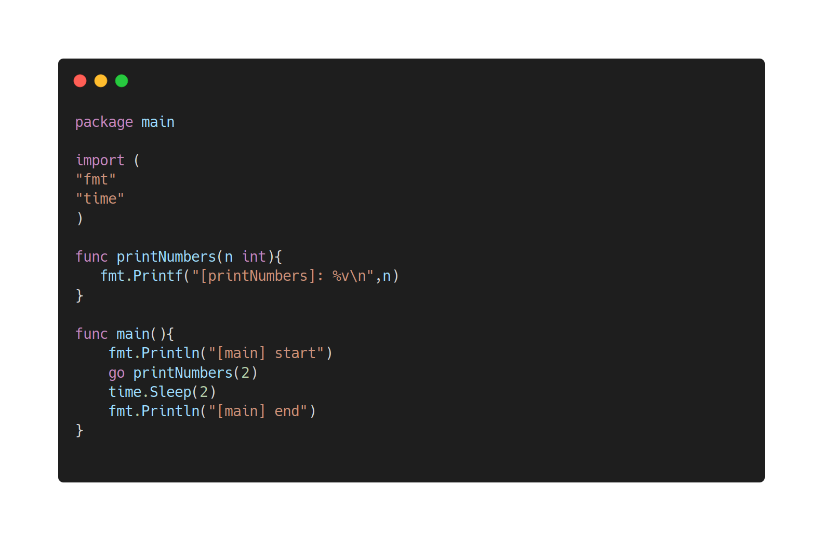
Goroutines
https://play.golang.org/p/wjtm0aGdLos
https://play.golang.org/p/fSviqBvgpbW
https://play.golang.org/p/A2rjrYajDYP
Notes:
Open normal program
Add routine
Add time sleep

Slide 56
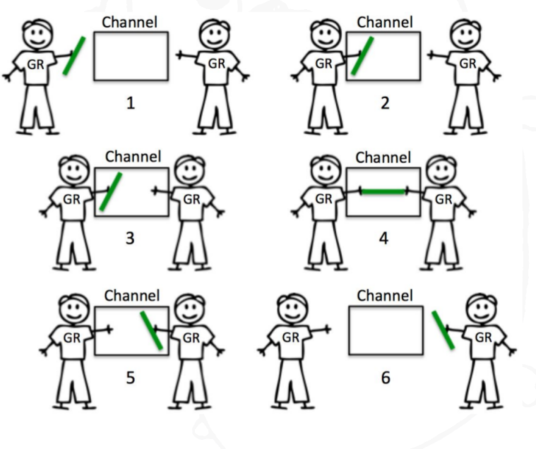

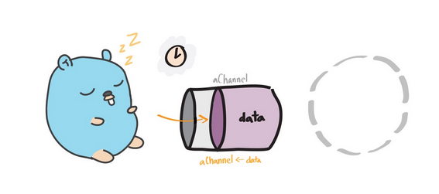
Go Channels
Unbuffered channels
No sender case
No receiver case

Slide 57
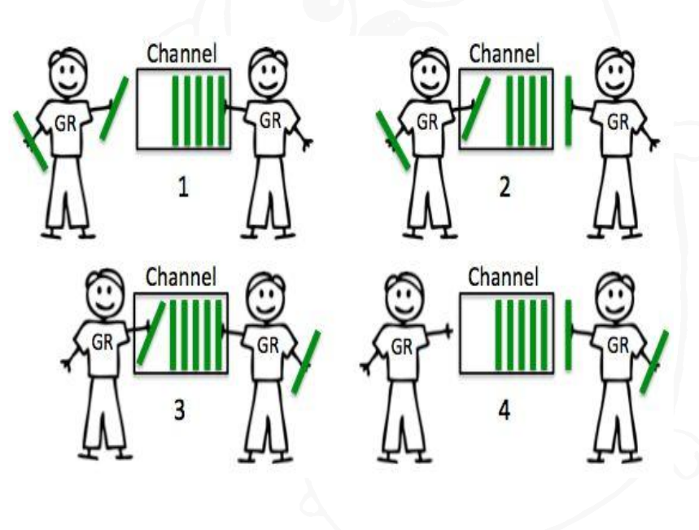
Go Channels
Buffered channels
No sender case
No receiver case

Slide 58
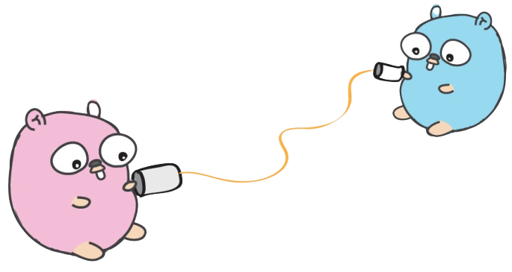
Go Channels
How they work
https://play.golang.org/p/_N1bd-hXQsD
Reading in a Loop
https://play.golang.org/p/xHqSwfpu5RL
Unbuffered VS Buffered
https://play.golang.org/p/xHqSwfpu5RL
https://play.golang.org/p/bCRQ4QagrAr
Closing
https://play.golang.org/p/5cfIdSxOxbg
https://play.golang.org/p/FgSEQw7gJ80
Don't communicate by sharing memory, share memory by communicating!

Slide 59

Wait groups
A WaitGroup waits for a collection of goroutines to finish.
The main goroutine calls Add to set the number of goroutines to wait for.
Each of the goroutines runs and calls Done when finished.
At the same time, Wait can be used to block until all goroutines have finished.
https://play.golang.org/p/pluDSf4uYZJ

Slide 60
Mutexes
channels are great for communication among goroutines
But what if we don't need communication?
What if we just want to make sure only one goroutine can access a variable at a time to avoid conflicts?
https://play.golang.org/p/7C0RPPG8eTP
Channels orchestrate, mutexes serialize!

Slide 61
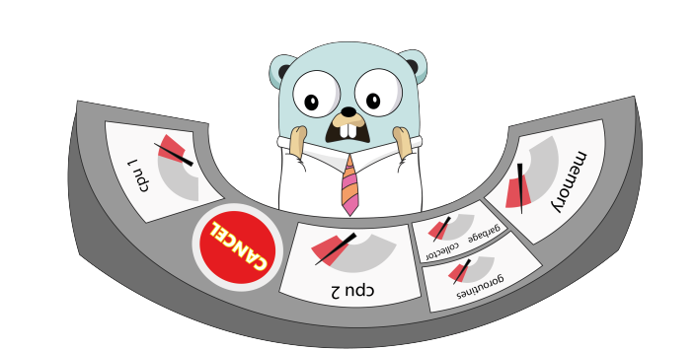
Context
Carries deadlines, cancelation signals, and other request-scoped values across API boundaries and between processes.
Cancellation
https://play.golang.org/p/QJtUFvv-l9M
Value passing
https://play.golang.org/p/lo0U6LaGCS7

Slide 62

Question time

Slide 63


